Slide 1

Chapter 3
Cascading
Style Sheets

Slide 2
3.1 Introduction
The CSS1 specification was developed in 1996
CSS2 was released in 1998
CSS3 is on its way
CSSs provide the means to control and change presentation of HTML documents
CSS is not technically HTML, but can be embedded in HTML documents
Style sheets allow you to impose a standard style on a whole document, or even a whole collection of documents
Style is specified for a tag by the values of its properties

Slide 3
3.2 Levels of Style Sheets
There are three levels of style sheets
  Inline - specified for a specific occurrence of a tag and apply only to that tag
  – This is fine-grain style, which defeats the purpose of style sheets - uniform style
  Document-level style sheets - apply to the whole document in which they appear
  External style sheets - can be applied to any number of documents
When more than one style sheet applies to a specific tag in a document, the lowest level style sheet has precedence
  In a sense, the browser searches for a style property spec, starting with inline, until it finds one (or there isn’t one)

Slide 4
3.2 Levels of Style Sheets (continued)
Inline style sheets appear in the tag itself
Document-level style sheets appear in the head of the document
External style sheets are in separate files, potentially on any server on the Internet
  Written as text files with the MIME type text/css

Slide 5
3.2 Linking an External Stylesheet
A <link> tag is used to specify that the browser is to fetch and use an external style sheet file
<link rel = "stylesheet" type = "text/css"
href = "http://www.wherever.org/termpaper.css">
</link>
External style sheets can be validated
  http://jigsaw.w3.org/css-validator/
  validator-upload.html

Slide 6
3.3 Style Specification Formats
Format depends on the level of the style sheet
Inline:
  Style sheet appears as the value of the style attribute
  General form:
  style = "property_1: value_1;
  property_2: value_2;
  …
  property_n: value_n"

Slide 7
3.3 Format for Document-level
Style sheet appears as a list of rules that are the content of a <style> tag
The <style> tag must include the type attribute, set to "text/css"
The list of rules must be placed in an HTML comment, because it is not HTML
Comments in the rule list must have a different form - use C comments (/*…*/)

Slide 8
3.3 General Form, Document Level
General form:
  <style type = "text/css">
  <!--
    rule list
  -->
  </style>
Form of the rules:
selector {list of property/values}
  Each property/value pair has the form:
  property: value
  Pairs are separated by semicolons, just as in the value of a <style> tag

Slide 9
3.3 General Form, External style sheets
Form is a list of style rules, as in the content of a <style> tag for document-level style sheets

Slide 10
3.4 Selector Forms: Simple
The selector is a tag name or a list of tag names, separated by commas
  h1, h3
  p
Contextual selectors
  ol ol li

Slide 11
3.4 Class Selectors
Used to allow different occurrences of the same tag to use different style specifications
A style class has a name, which is attached to a tag name
  p.narrow {property/value list}
  p.wide {property/value list}
The class you want on a particular occurrence of a tag is specified with the class attribute of the tag
For example,
  <p class = "narrow">
  ...
  </p>
  ...
  <p class = "wide">
  ...
  </p>

Slide 12
3.4 Generic Selectors
A generic class can be defined if you want a style to apply to more than one kind of tag
A generic class must be named, and the name must begin with a period
Example,
  .really-big { … }
Use it as if it were a normal style class
  <h1 class = "really-big"> … </h1>
  ...
  <p class = "really-big"> … </p>

Slide 13
3.4 id Selectors
An id selector allow the application of a style to one specific element
General form:
  #specific-id {property-value list}
Example:
  #section14 {font-size: 20}

Slide 14
3.4 Pseudo Classes
Pseudo classes are styles that apply when something happens, rather than because the target element simply exists
Names begin with colons
hover classes apply when the mouse cursor is over the element
focus classes apply when an element has focus

Slide 15
3.4 Pseudo Class Example
<!-- pseudo.html -->
<html xmlns = "http://www.w3.org/1999/xhtml">
<head> <title> Checkboxes </title>
<style type = "text/css">
input:hover {color: red;}
input:focus {color: green;}
</style>
</head>
<body>
<form action = "">
<p>
Your name:
<input type = "text" />
</p>
</form>
</body>
</html>

Slide 16
3.5 Properties
There are 60 different properties in 7 categories:
  Fonts
  Lists
  Alignment of text
  Margins
  Colors
  Backgrounds
  Borders

Slide 17
3.5 Property Values
Keywords - left, small, …
  Not case sensitive
Length - numbers, maybe with decimal points
Units:
  px - pixels
  in - inches
  cm - centimeters
  mm - millimeters
  pt - points
  pc - picas (12 points)
  em - height of the letter ‘m’
  ex-height - height of the letter ‘x’
  No space is allowed between the number and the unit specification e.g., 1.5 in is illegal!

Slide 18
3.5 Property Value Forms (continued)
Percentage - just a number followed immediately by a percent sign
URL values
  url(protocol://server/pathname)
Colors
  Color name
  rgb(n1, n2, n3)
    Numbers can be decimal or percentages
  Hex form: #XXXXXX
Property values are inherited by all nested tags, unless overridden

Slide 19
3.6 Font Properties
font-family
  Value is a list of font names - browser uses the first in the list it has
  font-family: Arial, Helvetica, Courier
  Generic fonts: serif, sans-serif, cursive, fantasy, and monospace (defined in CSS)
    Browser has a specific font for each

Slide 20
3.6 Font Properties (continued)
  If a font name has more than one word, it should be single-quoted
font-size
  Possible values: a length number or a name, such as smaller, xx-large, etc.
font-style
  italic, oblique (useless), normal
font-weight - degrees of boldness
  bolder, lighter, bold, normal
    Could specify as a multiple of 100 (100 – 900)
font
  For specifying a list of font properties
  font: bolder 14pt Arial Helvetica
  Order must be: style, weight, size, name(s)

Slide 21
3.6 Font Properties (continued)
> SHOW fonts.html and display
> SHOW fonts2.html and display
The text-decoration property
  line-through, overline, underline, none
  letter-spacing – value is any length property value
3.7 List properties
list-style-type
Unordered lists
  Bullet can be a disc (default), a square, or a circle
  Set it on either the <ul> or <li> tag
    On <ul>, it applies to list items
<h3> Some Common Single-Engine Aircraft </h3>
<ul style = "list-style-type: square">
<li> Cessna Skyhawk </li>
<li> Beechcraft Bonanza </li>
<li> Piper Cherokee </li>
</ul>

Slide 22
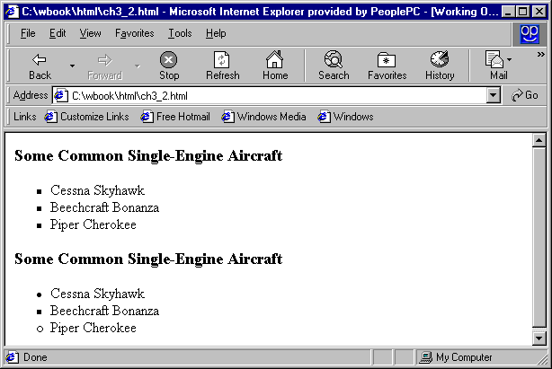
3.7 List properties (continued)
On <li>, list-style-type applies to just that item
<h3> Some Common Single-Engine Aircraft </h3>
<ul>
<li style = "list-style-type: disc">
Cessna Skyhawk </li>
<li style = "list-style-type: square">
Beechcraft Bonanza </li>
<li style = "list-style-type: circle">
Piper Cherokee </li>
</ul>

Slide 23
3.7 List properties (continued)
  Could use an image for the bullets in an unordered list
    Example:
      <li style = "list-style-image:
  url(bird.jpg)">
  On ordered lists - list-style-type can be used to change the sequence values
Property value Sequence type First four
Decimal Arabic numerals 1, 2, 3, 4
upper-alpha Uc letters A, B, C, D
lower-alpha Lc letters a, b, c, d
upper-roman Uc Roman I, II, III, IV
lower-roman Lc Roman i, ii, iii, iv
→ SHOW sequence_types.html and display
CSS2 has more, like lower-greek and hebrew

Slide 24
3.8 Colors
Color is a problem for the Web for two reasons:
  Monitors vary widely
  Browsers vary widely
There are three color collections
  There is a set of 16 colors that are guaranteed to be displayable by all graphical browsers on all color monitors
  black 000000 green 008000
  silver C0C0C0 lime 00FF00
  gray 808080 olive 808000
  white FFFFFF yellow FFFF00
  maroon 800000 navy 000080
  red FF0000 blue 0000FF
  purple 800080 teal 008080
  fuchia FF00FF aqua 00FFFF
  2. There is a much larger set, the Web Palette
  216 colors
  Use hex color values of 00, 33, 66, 99, CC, and FF
  Inside back cover of this book has them!

Slide 25
3.8 Colors (continued)
3. Any one of 16 million different colors
___________________________________________
The color property specifies the foreground color of elements
<style type = “text/css”>
th.red {color: red}
th.orange {color: orange}
</style>
…
<table border = "5">
<tr>
<th class = "red"> Apple </th>
<th class = "orange"> Orange </th>
<th class = "orange"> Screwdriver </th>
</tr>
</table>
The background-color property specifies the background color of elements
SHOW back_color.html and display

Slide 26
3.9 Alignment of Text
The text-indent property allows indentation
  Takes either a length or a % value
The text-align property has the possible values, left (the default), center, right, or justify
Sometimes we want text to flow around another element - the float property
  The float property has the possible values, left, right, and none (the default)
  If we have an element we want on the right, with text flowing on its left, we use the default text-align value (left) for the text and the right value for float on the element we want on the right

Slide 27

3.9 Alignment of Text (continued)
<img src = "c210.jpg"
style = "float: right" />
  Some text with the default alignment - left

Slide 28
3.10 The Box Model
Borders – every element has a border-style property
  Controls whether the element has a border and if so, the style of the border
  border-style values: none, dotted, dashed, and double
  border-width – thin, medium (default), thick, or a length value in pixels
  Border width can be specified for any of the four borders (e.g., border-top-width)
  border-color – any color
  Border color can be specified for any of the four borders (e.g., border-top-color)
  → SHOW borders.html and display

Slide 29
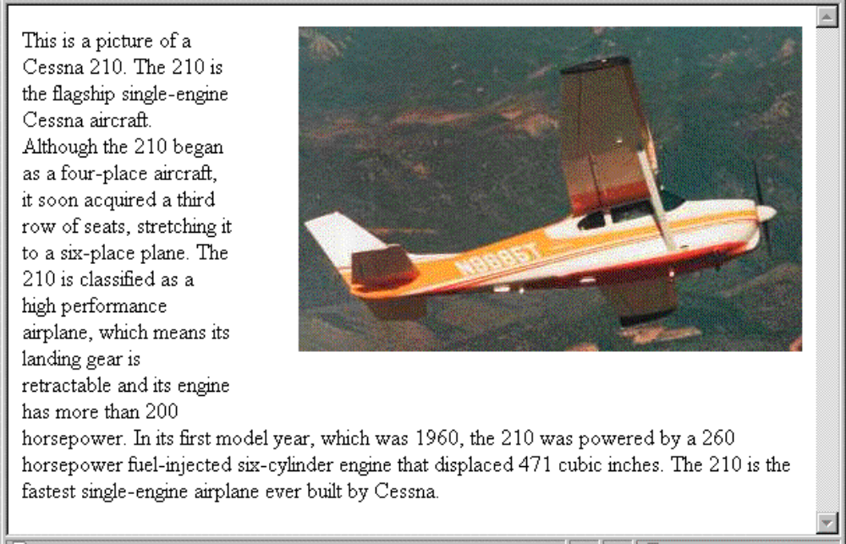
3.10 The Box Model (continued)
Margin – the space between the border of an element and its neighbor element
The margins around an element can be set with margin-left, etc. - just assign them a length value
<img src = "c210.jpg " style = "float: right;
margin-left: 0.35in;
margin-bottom: 0.35in" />

Slide 30
3.10 The Box Model (continued)
Padding – the distance between the content of an element and its border
  Controlled by padding, padding-left, etc.
SHOW marpads.html and display
3.11 Background Images
The background-image property
→ SHOW back_image.html and display
Repetition can be controlled
  background-repeat property
  Possible values: repeat (default), no-repeat, repeat-x, or repeat-y
  background-position property
    Possible values: top, center, bottom, left, or right

Slide 31
3.12 The <span> and <div> tags
One problem with the font properties is that they apply to whole elements, which are often too large
  Solution: a new tag to define an element in the content of a larger element - <span>
  The default meaning of <span> is to leave the content as it is
    <p>
    Now is the <span> best time </span> ever!
    </p>
  Use <span> to apply a document style sheet to its content
    <style type = "text/css">?
  bigred {font-size: 24pt;
  font-family: Ariel; color: red}
  </style>
  <p>
  Now is the
  <span class = "bigred">
  best time </span> ever!
  </p>

Slide 32
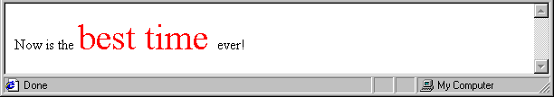
3.12 The <span> and <div> tags (continued)
The <span> tag is similar to other HTML tags, they can be nested and they have id and class attributes
Another tag that is useful for style specifications: <div>
  Used to create document sections (or divisions) for which style can be specified
    e.g., A section of five paragraphs for which you want some particular style

Slide 33
3.13 Conflict Resolution
When two or more rules apply to the same tag there are rules for deciding which rule applies
Document level
  In-line style sheets have precedence over document style sheets
  Document style sheets have precedence over external style sheets
Within the same level there can be conflicts
  A tag may be used twice as a selector
  A tag may inherit a property and also be used as a selector
Style sheets can have different sources
  The author of a document may specify styles
  The user, through browser settings, may specify styles
Individual properties can be specified as important

Slide 34
3.13 Precedence Rules
From highest to lowest
Important declarations with user origin
Important declarations with author origin
Normal declarations with author origin
Normal declarations with user origin
Any declarations with browser (or other user agent) origin

Slide 35
3.13 Tie-Breakers
Specificity
  id selectors
  Class and pseudo-class selectors
  Contextual selectors
  General selectors
Position
  Essentially, later has precedence over earlier

